Slide 1
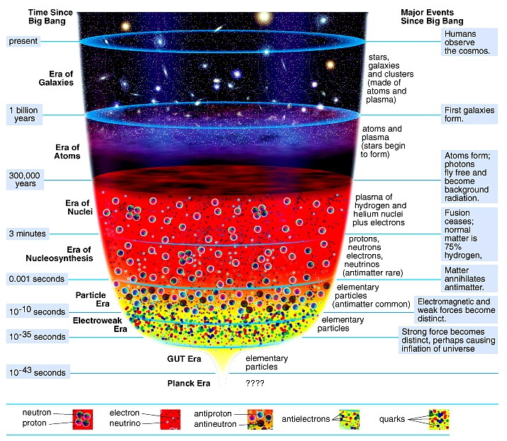

Slide 2
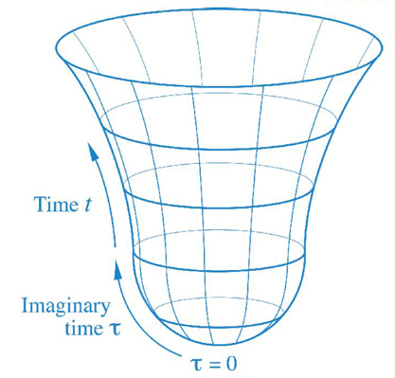
Title:

Slide 3
t = 1 sec.: Forces exists; electromagnetic forces become distinct.
Matter annihilates antimatter.
t = 3 min.: Protons, neutrons, and electrons become distinct.
Nuclear fusion ceases.
Normal matter is 75% H.
t = 300,000 years: Atoms (H & He) form.
Photons fly freely and become background radiation.
Stars begin to form.
t = 1 billion years: First galaxies form—made of clusters of stars, single stars and other galaxies.
T = 13.7 billion years: Present day

