Slide 1
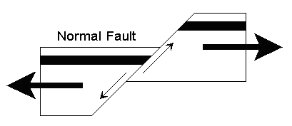
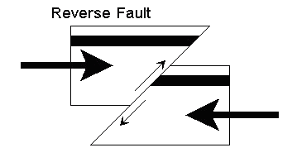
Chapter 4.1 Forces of Earth’s Crust PRACTICE QUIZ
Name: Class: Date:
Can you complete the table?
--STRESS/FORCE--
-- TYPE OF FAULT--
--MOTION AT FAULT--
PLATE BOUNDARY
Divergent
Convergent
Transform
Look at the large arrows to decide which type of boundary and stress is diagrammed.
Label which wall is the foot wall (FW) and which is the hanging wall (HW). Use this information to determine if the hanging wall slides up or down the foot wall.
Determine if this boundary has a Normal, Reverse or Strike-slip fault.
Boundary:
Stress/Force:
Fault:
Motion:
Boundary:
Stress/Force:
Fault:
Motion:
Boundary:
Stress/Force:
Fault:
Motion:
Boundary:
Stress/Force:
Fault:
Motion:

Slide 2
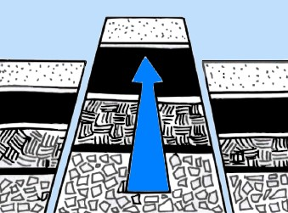
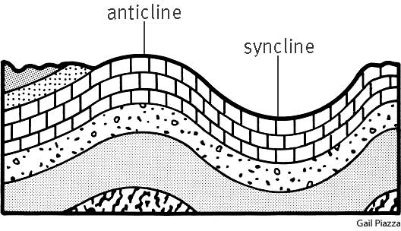
Draw a rift valley in this diagram.
Draw a fault-block mountain in this diagram.
Label the syncline and anticline fold.

Slide 3
Chapter 4.1 Forces of Earth’s Crust KEY PRACTICE QUIZ
Name: Class: Date:
Can you complete the table?
--STRESS/FORCE--
-- TYPE OF FAULT--
--MOTION AT FAULT--
PLATE BOUNDARY
Divergent
TENSION
NORMAL
HW slides down FW
Convergent
COMPRESSION
REVERSE
HW slide up FW
Transform
SHEARING
STRIKE-SLIP
NO HW/FW; ROCK SLIDES PAST EACH OTHER
Look at the large arrows to decide which type of boundary and stress is diagrammed.
Label which wall is the foot wall (FW) and which is the hanging wall (HW). Use this information to determine if the hanging wall slides up or down the foot wall.
Determine if this boundary has a Normal, Reverse or Strike-slip fault.
FW
FW
HW
HW
Boundary: DIVERGENT
Stress/Force: TENSION
Fault: NORMAL
Motion: HW slides down FW
Boundary: DIVERGENT
Stress/Force: TENSION
Fault: NORMAL
Motion: HW slides down FW
HW
HW
FW
FW
Boundary: CONVERGENT
Stress/Force: COMPRESSION
Fault: REVERSE
Motion: HW slides up FW
Boundary: CONVERGENT
Stress/Force: COMPRESSION
Fault: REVERSE
Motion: HW slides up FW

Slide 4
Draw a rift valley in this diagram.
Draw a fault-block mountain in this diagram.
Label the syncline and anticline fold.
anticline
syncline

