Slide 1
Giant Star
Characteristics of Stars
Name: Date:
Stars are huge spheres of glowing .
Stars are mostly made up of
.
Stars produce energy through the process of
.
Astronomers classify stars by their physical characteristics, including:
1)
2)
3)
4)
5)
White Dwarf
Medium Star
Large Star
A star’s color reveals its
.
Red star surface temp. =
Yellow star surface temp =
Bluish star surface temp =
BRIGHTNESS
Brightness is the amount of
a star gives off.
A star’s ABSOLUTE brightness depends on its:
1)
2)
The chemical composition of most stars is about:
Hydrogen =
Helium =
Other elements=
But a star’s APPARENT brightness depends on its:
1)
2)

Slide 2
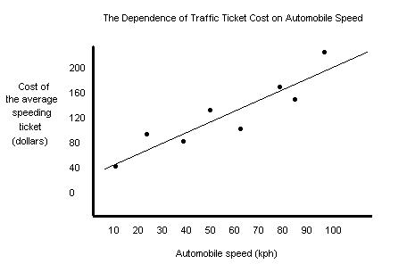
Parts of a Line Graph
Name: Class: Date:
What Makes This a Great Graph?
Title: What is the name of this graph?
(“The Dependence of (Your Dependent Variable) on (Your Independent Variable”)
X-Axis (Independent Variable): What is the x-axis label?
Y-Axis (Dependent Variable): What is the y-axis label?
Do both the x-axis and y-axis have labeled units?
What are the units for the x-axis?
What are the unit for the y-axis?
Think About It!
Why do you think the Independent Variable is also called the Manipulated Variable?
Why do you think the Dependent Variable is also called the Responding Variable?

