Slide 1
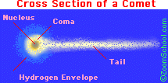
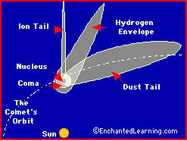

Slide 2
TEACHER NOTES
coma - The roughly spherical blob of gas that surrounds the nucleus of a comet; it is about a million km across. The coma is comprised of water vapor, carbon dioxide gas, and other neutral gases that have sublimed (evaporated from a solid, skipping the liquid phase) from the solid nucleus.
dust tail - A long, wide tail buffeted by photons emitted from the Sun, but it curves slightly due to the comet's motion.
hydrogen envelope - Hydrogen gas that surrounds the coma of the comet and trails along for millions of miles (it is usually between the ion tail and the dust tail). The hydrogen envelope is about 10 million km across at the nucleus of the comet and about 100 million km long.
ion tail - A tail of charged gas particles (ions) that always faces away from the sun because the solar wind (composed of ions streaming from the sun at high velocities) pushes it away.
nucleus - The frozen center of the comet's head. It is made of ice, gas, and dust. It contains most of the comet's mass but is very small (about 1 to 10 km across).

Slide 3
