Slide 1
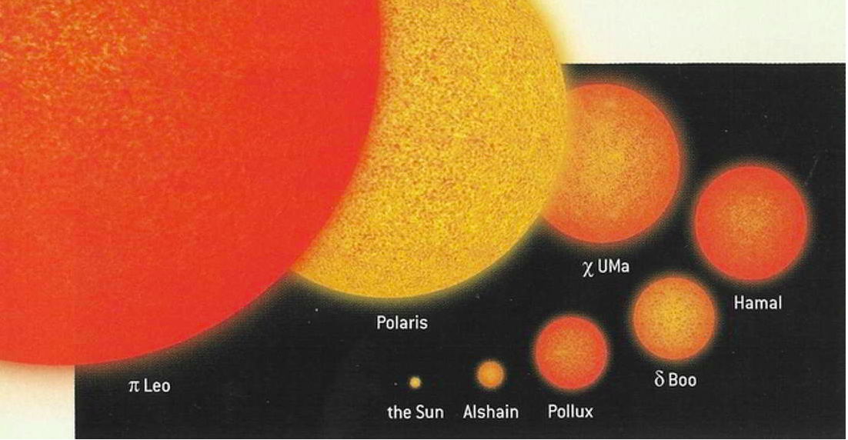
Comparing Our Sun to Other Stars

Slide 2
