Slide 1
Earth’s Structure Foldable: Rubric
Name: Class: Due:
Earth’s layers are neatly colored according to below instructions. /20 pts
Inner Core Color 1
Out Core Color 2
Lower Mantle/Mesosphere Color 3
Middle Mantle/Asthenosphere Color 4
Upper Mantle/Lithosphere Color 5
Oceanic Crust Dark Brown
Continental Curst Light Brown
Ocean Blue
Mountains/Land Various Greens
Earth’s layers are neatly cut and separated. /10 pts
*Remember, the lithosphere also consists of the Earth’s crust.
Leave the two connected.
Earth’s layers are neatly glued/taped to the tops of five different /10 pts.
pieces of paper.
The papers are neatly aligned, stacked, folded and stapled. /10 pts
All 12 labels are neatly and correctly placed on the illustration. /15 pts.
All four information boxes are completed with correct information. /20 pts.
One additional important fact is added about each of the layers.
Project is well constructed and is grade-level appropriate, /5 pts.
with respect to professional looking.
Handwriting is neat. /5 pts.
Grammatical errors = -1 pt each up to five points. /5 pts.

Slide 2
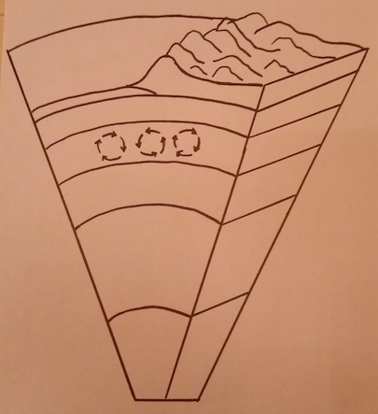

Slide 3
Earth’s Structure
Oceanic Crust
Continental Crust
Lithosphere
Upper Mantle
Asthenosphere
Middle Mantle
Convection Currents
Mesosphere
Lower Mantle
Outer Core
Inner Core
Name:
Class:
Date:¨

Slide 4
Crust Thickness:
Composition:
Upper Mantle: Lithosphere Thickness:
Composition:
Middle Mantle: Asthenosphere Thickness:
Composition:
Lower Mantle: Mesosphere Thickness:
Composition:
Outer Core Inner Core
Thickness: Thickness:
Composition: Composition:

