Slide 1
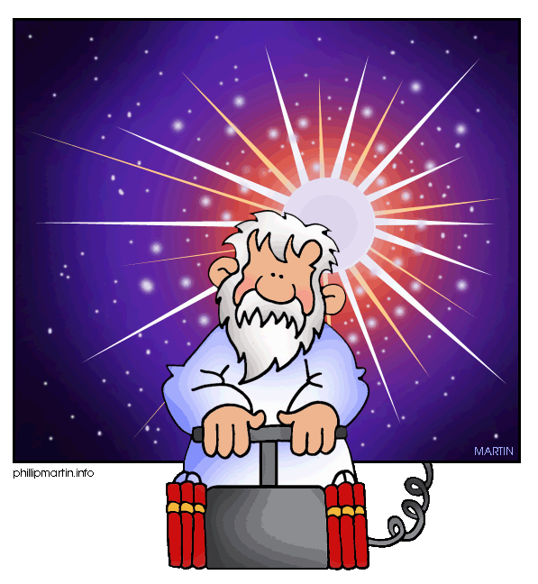
Four Pieces of Evidence Supporting the Big Bang Theory

Slide 2
Four Pieces of Evidence Supporting the Big Bang Theory
Expanding Universe (Hubble)
Red Shift (Hubble)
Background Cosmic Radiation (Penzias & Wilson)
Abundance of Elements

