Slide 1
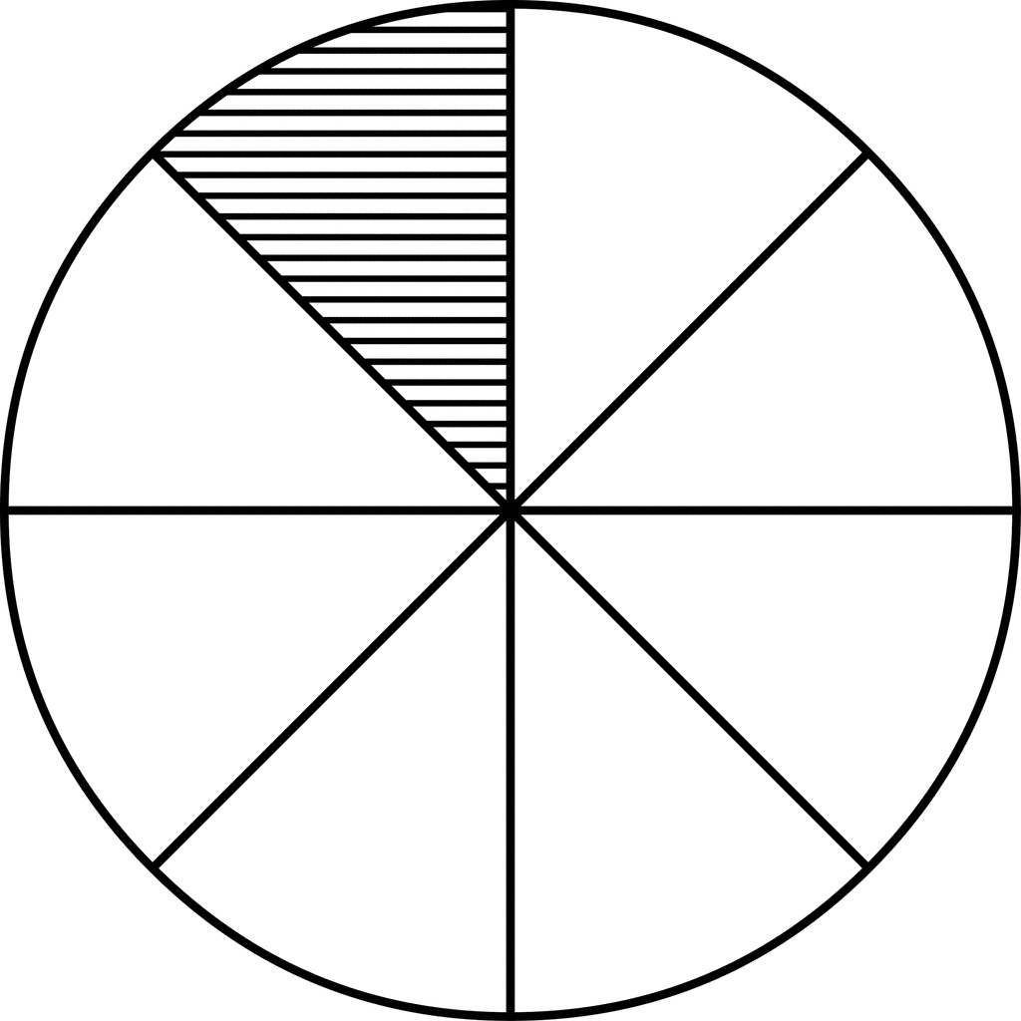
Graphing Data: Test
Name: Class: Date:
You will be creating a pie chart AND a bar chart. One table of information should be presented in a pie chart; one table of information should be present in a bar chart. Choose the correct chart for the body of data. Then, graphically represent the data in a neat, colorful chart.
Check List
I chose the correct chart to graphically represent the data.
I used a LARGE round template to draw a neat circle for my pie chart. Do not make your pie chart too small—difficult for any reader to read.
I used a ruler or straight edge to draw ALL my straight lines.
Both of my charts have serious (not silly or cute) titles that tells any reader the data that is being presented. (Any reader should be able to Google a topic and find your information—a silly or cute title would not allow this.)
I have labeled both the x-axis and y-axis on the bar chart.
In both of my charts, I have the actual number/percent stated.
When I eye-ball my charts, I have slices of pies or bars that are visually close to the data number being presented.
In my pie chart, all my data numbers are either inside the slice or outside the slice. They can only go inside the slice, if ALL numbers neatly fit in the slice. If my pie chart numbers are outside the slice, then I have used a rule to draw a straight line from the number to the slice. I have not used any colors that are too dark for any reader to read my data—if data is inside the slice.
All my graphs are colorful and visually appealing.
Substances That Deplete Earth’s Ozone Layer of the Atmosphere
Solvent Cleaning Products 36%
Refrigeration and AC Products 30%
Foam Products 14%
Aerosols 5%
Other Products 15%

