Slide 1
Ch. 4.6 The Expanding Universe Teacher’s Notes
Moving Galaxies: In the 1920s, American astronomer, Edwin Hubble, discovered important evidence that led to the Big Bang Theory. He discovered that almost all galaxies are moving away from us and each other.
Hubble’s Law: The farther away a galaxy is, the faster it is moving away from us.
Universe time = 100 years.
Nine different sources of light.
Universe time = 1,000,000 years.
Same nine sources of light.

Slide 2
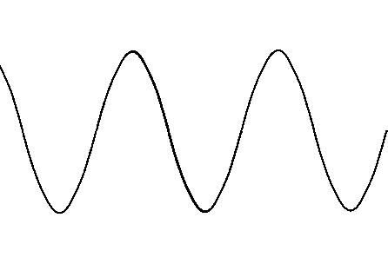
Ch. 4.6 The Expanding Universe Teacher’s Notes
Red Shift. This theory accompanies Hubble’s Law. However much the universe expands is the same ratio the light wavelength increases.
Universe time = 100 years.
Wavelength of light when first emitted from light source.
Universe time = 1,000,000 years.
If universe expands 3x its size; then, light wavelength increases 3x.

Slide 4
