Slide 1
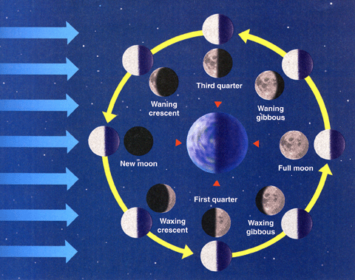

Slide 2
Draw each phase—as you see it with your eyes. Label each phase.

