Slide 1
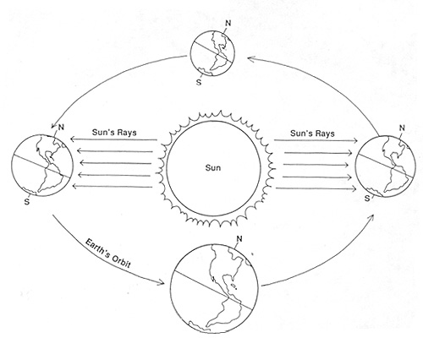
Solstices & Equinoxes
For the northern hemisphere, label:
Summer Solstice
Winter Solstice
Vernal (Spring) Equinox
Autumnal Equinox
Put the approximate dates for each.

Slide 2
After labeling the diagram, answer the following questions.
When does the northern hemisphere receive the most direct sunlight?
When does the northern hemisphere receive the least direct sunlight/most indirect sunlight?
When does the northern hemisphere have equal direct/indirect sunlight? (Two answers)
The day after the Vernal equinox, is the northern hemisphere heading toward winter or summer?
The day after the Autumnal equinox, is the northern hemisphere heading toward winter or summer?

