Slide 1
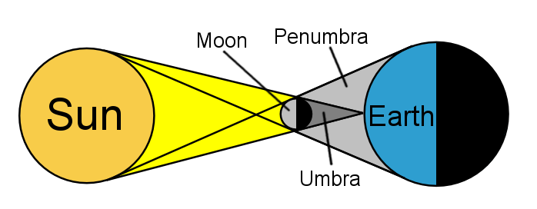
Draw the solar eclipse diagram into your notebook. (Do not just cut and paste.) Color it the same colors as the illustration
Draw the solar eclipse diagram into your notebook. (Do not just cut and paste.) Color it the same colors as the illustration
Complete the two sentences below your diagram:
Viewers in the umbra see a total/partial eclipse.
Viewers in the penumbra see a total/partial eclipse.
Complete the two sentences below your diagram:
Viewers in the umbra see a total/partial eclipse.
Viewers in the penumbra see a total/partial eclipse.

