Slide 1
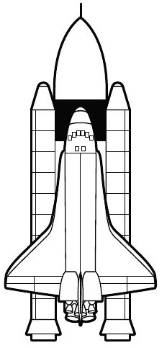
NEWTON’S
THIRD LAW OF MOTION
Name:
Date: Class:
State Newton III:
Three forces acting on the rocket.
1)
2)
3)
Draw an arrow for each of the forces showing the direction of the force on the rocket. Label the arrows.
Measure your arrows. The two downward arrows MUST equal the one upward arrow.
Color the illustration.

Slide 2
NEWTON’S
THIRD LAW OF MOTION
Name: KEY
Date: Class:
State Newton III:
For every action, there is an equal and opposite reaction.
Three forces acting on the rocket.
1) Thrust (arrow up)
2) Weight of rocket (arrow down)
3) Air friction (arrow down)
Draw an arrow for each of the forces showing the direction of the force on the rocket. Label the arrows.
Measure your arrows. The two downward arrows MUST equal the one upward arrow.
Color the illustration.
Thrust
Air Friction
Rocket Weight

