Slide 1
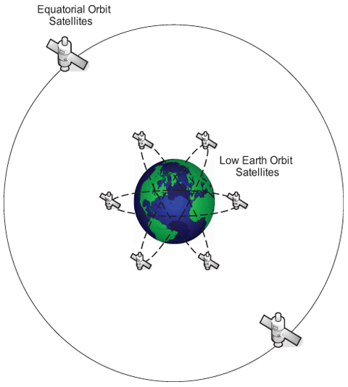
Space Junk
Source: National Geographic: Orbital Objects.
The U.S. Space Surveillance Network uses radar to track more than 13,000 orbital objects--items that are larger than four inches (ten centimeters). This celestial clutter includes everything from the International Space Station (ISS) and the Hubble Space Telescope to defunct satellites, rocket stages, or nuts and bolts left behind by astronauts. And there are millions of smaller, harder-to-track objects such as flecks of paint and bits of plastic.
Geosynchronous
Satellites
Satellites in low-Earth orbit, or LEO, stay within 500 and travel extremely fast—17,000 mph or more—to keep from being drawn back into Earth's atmosphere. Most satellites around Earth are found in the LEO range.
Other objects are sent much farther into space and placed in what is called geosynchronous orbit. This allows the satellite to match the Earth's rotation and "hover" over the same spot at all times. Weather and television satellites are generally in this category.
Orbital debris, the technical term for nonfunctional and human-made space junk, includes not only whole, abandoned satellites, but also pieces of broken satellites, deployed rocket bodies, human waste, and other random objects, like the glove lost by astronaut Ed White during his historic 1965 spacewalk. The oldest known piece of orbital debris is the 1958 Vanguard 1 research satellite, which ceased all functions in 1964. One of the newest is a refrigerator-size ammonia reservoir released into its own orbit in July 2007, following a NASA decision that no other disposal options were feasible.

Slide 2
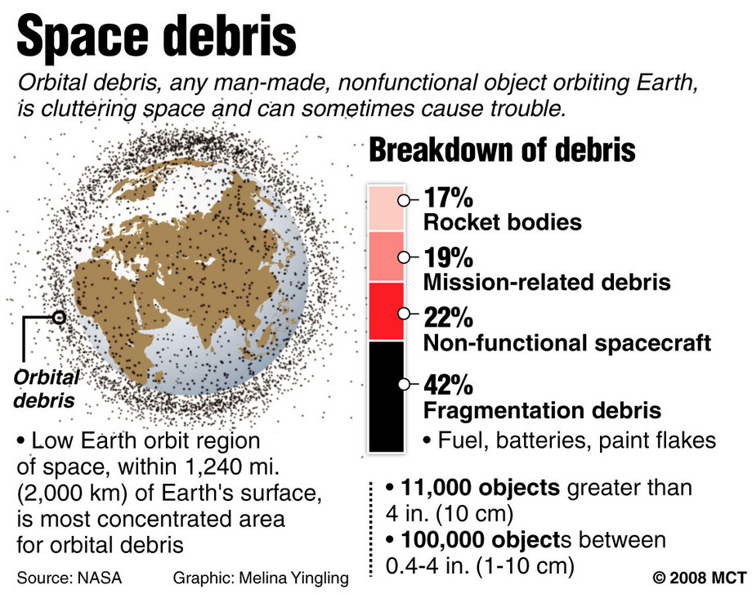
Space Junk
Like satellites, LEO debris whizzes around the planet at 17,000 miles an hour (27,400 kilometers an hour) or more. The orbits of these objects differ in direction, orbital plane, and speed, however—meaning collisions are inevitable. At such speeds, termed hypervelocity, even a miniscule piece of junk presents a serious hazard for satellites, spacecraft, and spacewalking astronauts.
Gravitational pull will ensure that anything we've ever put in orbit will eventually make its way back to Earth. And though thus far no one has ever been killed by reentering space debris, NASA estimates on average one piece returns to Earth each day.
NASA and other national space agencies have identified orbital debris as a serious problem and are currently devising plans to mitigate existing space junk and curb future debris.

