Slide 1
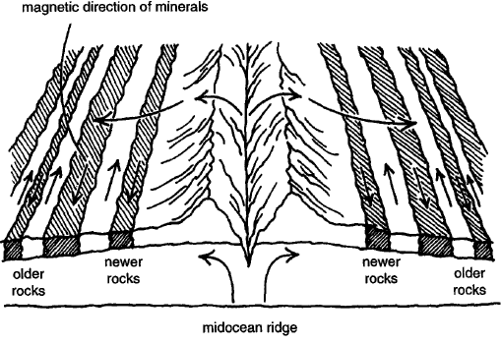
Sea-Floor Spreading

