Slide 1
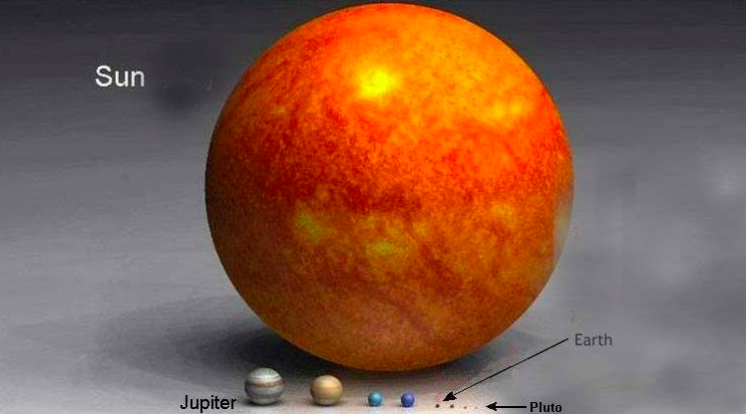
Comparing Sun and Planet Sizes

