Slide 2
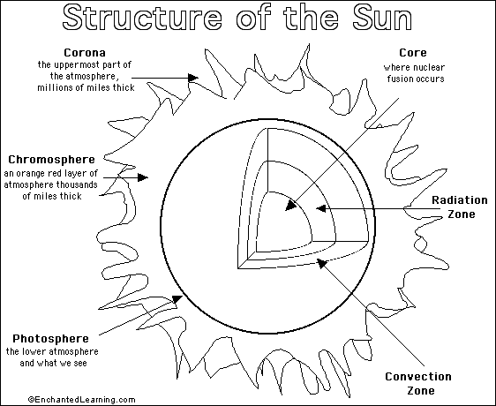

Slide 3
Layers of the Sun
Name: Class: Date:
Reading Comprehension. Read pages 89 – 91 in your textbook. Write ONLY one sentence for each layer of the sun’s interior
and atmosphere that summarizes each paragraph—but includes three facts. Cut these out and tape/glue in your science notebook.
Interior Atmosphere
Core
Photosphere
Radiation Zone
Chromosphere
Convection Zone
Corona

