Slide 1
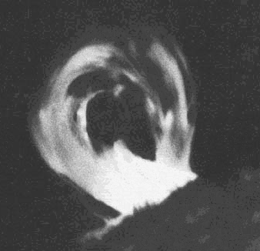
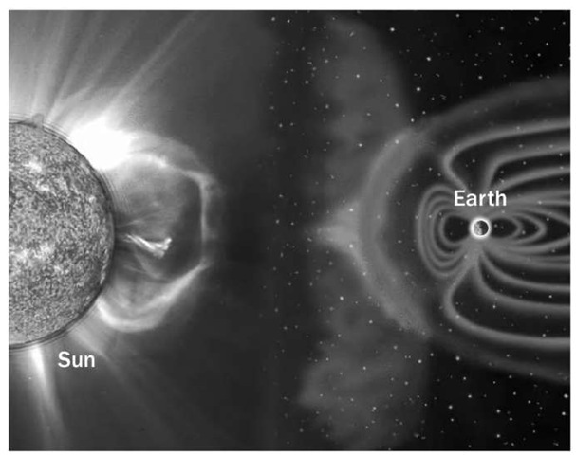
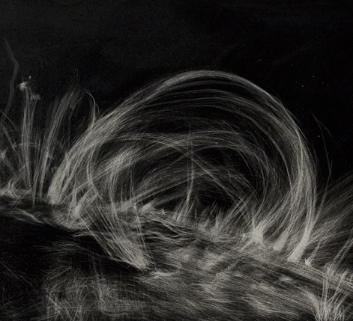

Slide 2
Sun Spots
Areas of gas on surface that are cooler than gases around them.
Cooler gases do not emit as much light at hotter gas—therefore the area is darker.
Have an 11-year cycle. Occur in groups.
Prominences
Huge loops of gas.
Prominences often link different parts of sunspot regions.
Solar Flares
Loops in sunspot regions (prominences) suddenly connect—releasing large amounts of magnetic energy.
The energy causes the gas to erupt into space.
These eruptions are called Solar Flares.
Solar Winds
Comprised of electrical particles from the sun.
These winds reach Earth’s upper atmosphere.
AUROROAS: Earth’s atmosphere and magnetic field usually block these particles. But near N/S poles the particles can enter atmosphere and create powerful electric current that cause gas particles in atmosphere glow.

