Slide 1
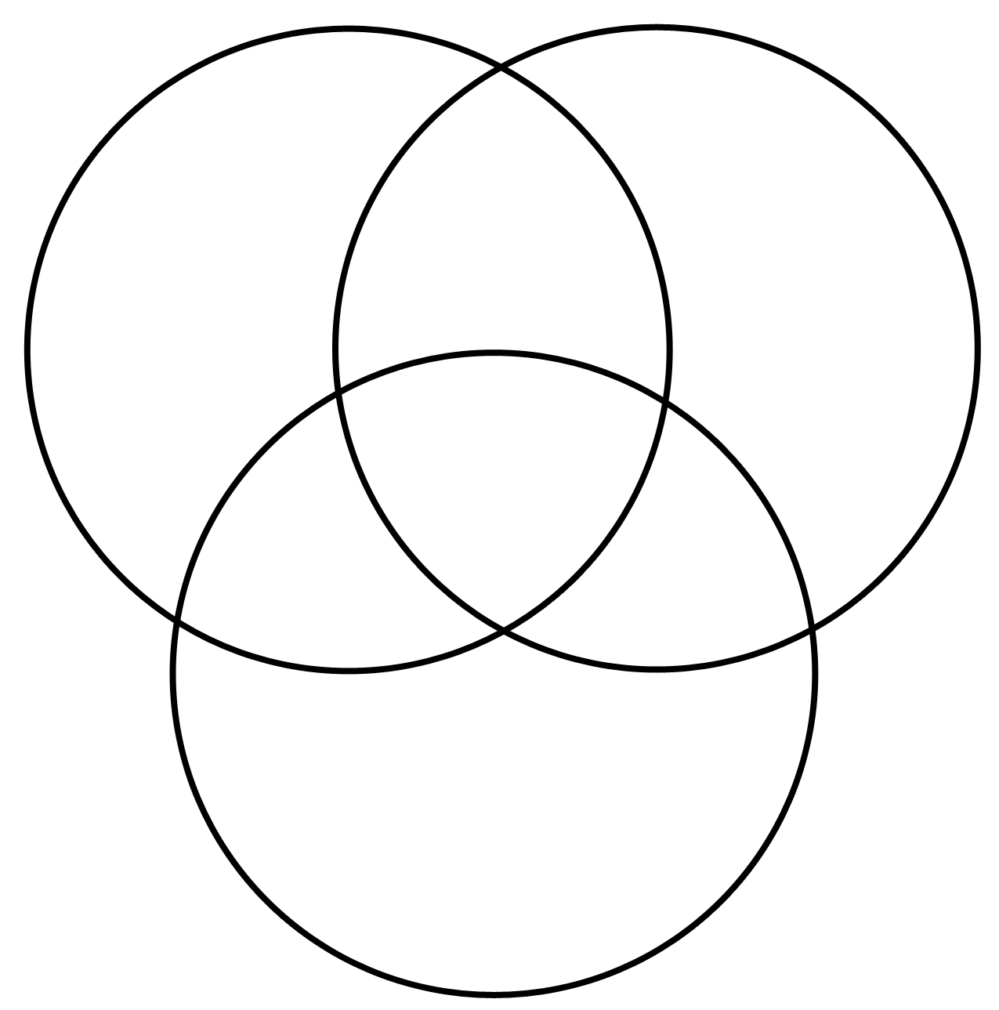
Strategy: Similarities & Differences
Label It:

